Slide 1

Cyber Attacks
Ibrahim Ghali & Hamza Zarai
Computer Sciences Department
Faculty of Sciences of Sfax

Slide 2

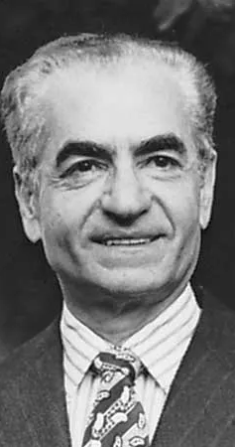
1957: Atoms for Peace Begins
• Iran joins U.S. Atoms for Peace.
• Shah dreams of nuclear energy.
• Builds Bushehr with Western help.
• Aims for modern, oil-free future.

Slide 3
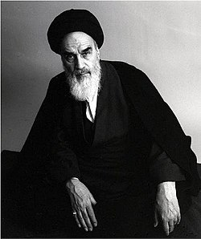
1979: Revolution Stops Progress
• Islamic Revolution ousts Shah.
• Khomeini halts nuclear program.
• Calls it Western evil.
• Plants like Bushehr abandoned.

Slide 4

1980s: Secret Nuclear Restart
• Iran-Iraq War sparks revival.
• Buys centrifuge plans from Khan.
• Russia, China aid Natanz.
• Aims for national strength.

Slide 5
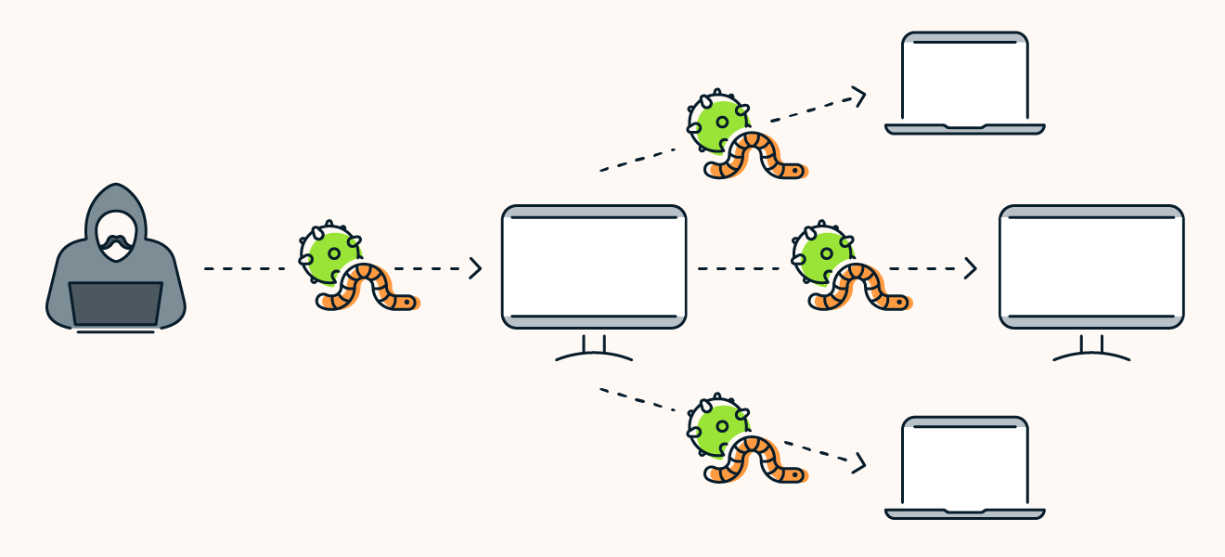
2009: Stuxnet Strikes Natanz
• Stuxnet virus destroys 1,000 centrifuges.
• U.S., Israel blamed for attack.
• Delays Iran’s nuclear plans.
• Shows cyberattack power.

Slide 6
Why Cybersecurity Matters
• Stuxnet reveals cyber risks.
• Attacks cost $10.5T in 2025.
• Threaten power, water, safety.
• Need to protect our world.

Slide 7
Our Cybersecurity Project
• Analyzes 40,000 cyber attacks.
• Covers 2020–2023 incidents.
• Studies attack types, impacts.
• Inspired by Stuxnet’s lessons.

Slide 8
Key Findings: Attack Types
• Malware: 50%, like Stuxnet.
• DDoS: 30%, disrupts systems.
• Intrusion: 20%, steals data.
• Targets critical infrastructure.

Slide 9
Severity of Attacks
• Low severity: 40% of attacks.
• Medium: 35%, moderate impact.
• High: 25%, like Stuxnet.
• Varies by attack type.

Slide 10
Project Goals
• Understand cyber threat patterns.
• Develop stronger defenses.
• Protect systems like Natanz.
• Build a safer digital world.

Slide 11
Trend: Attack Frequency
• Attacks peaked in 2023.
• Malware incidents rose steadily.
• DDoS spikes during conflicts.
• Reflects growing cyber threats.

Slide 12
Geographical Attack Patterns
• North America: High Malware.
• Asia: Frequent DDoS attacks.
• Europe: Intrusion common.
• Global threat distribution.

Slide 13
Targeted Protocols
• HTTP: 40% of attacks.
• DNS: 30%, like Stuxnet.
• FTP: 20%, data theft.
• Critical for infrastructure.

Slide 14
Malware: The Top Threat
• 50% of attacks, like Stuxnet.
• Targets industrial systems.
• Spreads via USB, email.
• Causes major disruptions.

Slide 15
DDoS: System Overload
• 30% of attacks flood networks.
• Disrupts critical services.
• High severity in 2023.
• Targets government, finance.

Slide 16
Intrusion: Data Breaches
• 20% of attacks steal data.
• Targets sensitive systems.
• Often high severity.
• Requires strong defenses.

Slide 17
Severity and Attack Types
• Malware: Often low/medium severity.
• DDoS, Intrusion: High severity.
• Impacts vary by target.
• Guides defense priorities.

Slide 18
Impact on Users/Devices
• Users lose data, access.
• Devices face downtime, damage.
• Malware affects most users.
• Critical for protection.

Slide 19
Case Study: Malware Attack
• 2023: Malware hits hospital.
• Disrupts patient care systems.
• Medium severity, high impact.
• Echoes Stuxnet’s disruption.

Slide 20
Case Study: DDoS Incident
• 2022: DDoS floods bank.
• Halts online transactions.
• High severity, financial loss.
• Shows global risks.

Slide 21
Preventing Cyber Attacks
• Use strong firewalls.
• Update software regularly.
• Train staff on security.
• Block USB vulnerabilities.

Slide 22
Detecting Threats Early
• Deploy IDS/IPS systems.
• Use machine learning models.
• Monitor network anomalies.
• Catch Stuxnet-like malware.

Slide 23
Responding to Attacks
• Isolate affected systems.
• Analyze attack vectors.
• Restore from backups.
• Report to authorities.

Slide 24

Cybersecurity Best Practices
• Enforce strong passwords.
• Use multi-factor authentication.
• Conduct regular audits.
• Educate all employees.

Slide 25
Emerging Cyber Threats
• AI-driven attacks increase.
• IoT devices vulnerable.
• Quantum computing risks.
• Prepare for next Stuxnet.

Slide 26
Project Summary
• Studied 40,000 cyber incidents.
• Malware, DDoS top threats.
• Inspired by Iran’s story.
• Aims for global safety.

Slide 27
Our Recommendations
• Invest in cybersecurity tools.
• Train staff regularly.
• Share threat intelligence.
• Strengthen global defenses.

Slide 28
Thank You!
• Questions? Comments?
• Contact: [Your Email]
• Let’s discuss cybersecurity!
• Together, we’ll succeed.

Slide 29
References
• IAEA: Atoms for Peace.
• Symantec: Stuxnet Report.
• Kaggle: Cybersecurity Dataset.
• NIST Cybersecurity Framework.

